Slide 1
Object Oriented Programming
Inheritance & Polymorphism

Slide 2
Topics
Inheritance
Protected
Derived classes
Polymorphism
Static
Function Overloading
Operator Overloading
Dynamic
Abstract class & methods with override
Virtual Functions & Override

Slide 3
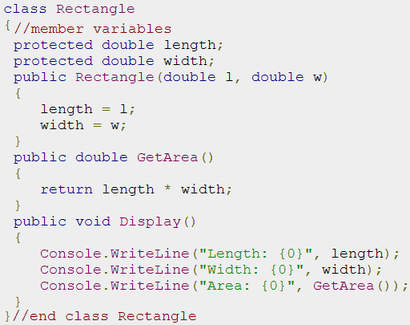
Inheritance - base class

Slide 4
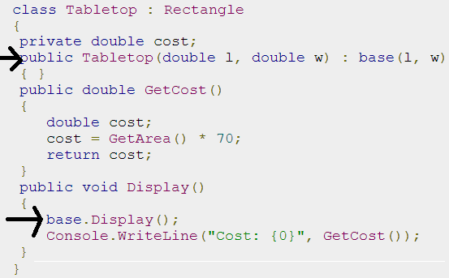

Inheritance - derived class

Slide 5
Polymorphism
Static (early binding)
Function Overloading – already done
Operator Overloading - next topic
Dynamic (late binding)
Abstract class & methods with override
Virtual Functions & Override

Slide 6
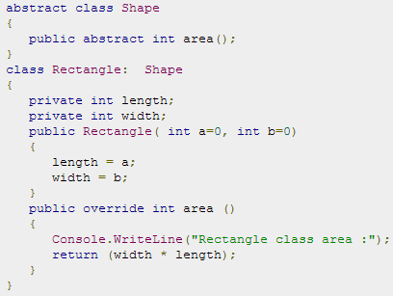

Dynamic – Abstract Class/Function

Slide 7
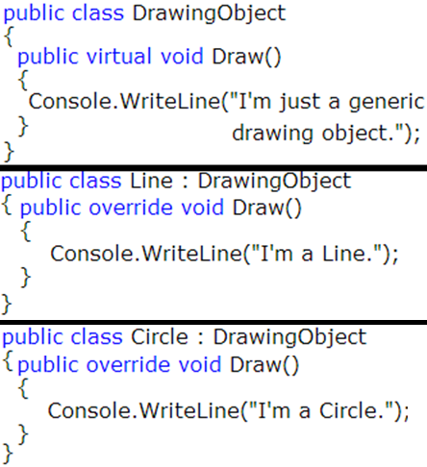
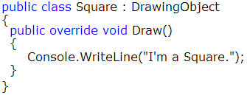
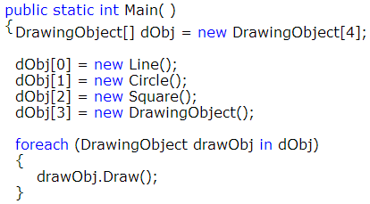
Virtual Functions

Slide 8
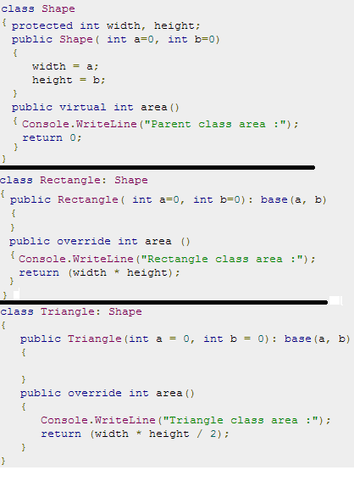
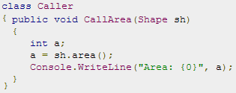
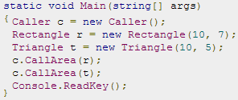
Virtual Functions

